Slide 1
Software Quality Assurance
Dr. Seemab Latif
Lecture No. 1
4th October, 2010

Slide 2
Contact Information
Instructor: Dr. Seemab Latif
Email: seemab@mcs.edu.pk
Office hours:
Friday, 09:00 - 11:00, Lab 2
Teacher’s Assistant: Rabiya Rashid
Rabiya.rashid@hotmail.com

Slide 3
Books to Follow
Software Quality Engineering: Testing, Quality Assurance, and Quantifiable Improvement: JEFF TIAN, 2005.
A Practitioner’s Guide to Software Test Design: LEE COOPELAND, 2004
Software Testing and Quality Assurance, Theory and Practice: KSHIRASAGAR NAIK, PRIYADARSHI TRIPATHY, 2008.

Slide 4
Grading
Factors:
Grading
Mid Term - 25%
End Term - 45%
Quiz - 10 %
Assignment - 10 %
Project - 10 %
Late Policy: Usually each assignment has one week time to finish; Assignments will not be accepted later without the express permission of the instructor or the teaching assistant.

Slide 5
Quizzes and Assignments
Quiz- minimum 4 quizzes
Maximum----no limit
Assignment- 2 assignments
1 before mid term
1 after mid term
Dr. Seemab Latif

Slide 6
Project
Group members: 4-6 students
Choose a project that can be divided into smaller modules.
What is required?
Perform Black box and White box testing on the project
Each group has to perform four testing levels on the project namely:
Unit Testing
Integration Testing
System Testing
Acceptance Testing
Regression Testing
A detailed Testing Report
Start working on the project from the beginning

Slide 7
Some General Comments
Encouragement to ask questions during class
Without your feedback, it is impossible for me to know what you don’t know
There is no reason not to ask questions during class
Of course, you could also send email, or meet in person
Encouragement to read course material prior to class

Slide 8
Why Software Quality Assurance?
Software errors cost the U.S. economy $60 billion annually in rework, lost productivity and actual damages. We all know software bugs can be annoying, but faulty software can also be expensive, embarrassing, destructive and deadly. Following are some of the famous software “disasters”:

Slide 9

1. Mariner Bugs Out (1962)
Disaster: The Mariner 1 rocket with a space probe headed for Venus diverted from its intended flight path shortly after launch. Mission Control destroyed the rocket 293 seconds after liftoff.
Cost: $18.5 million
Cause: A programmer incorrectly transcribed a handwritten formula into computer code, missing a single superscript bar. Without the smoothing function indicated by the bar, the software treated normal variations of velocity as if they were serious, causing faulty corrections that sent the rocket off course.

Slide 10
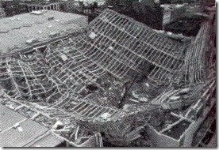
2. Hartford Coliseum Collapse (1978)
Disaster: Just hours after thousands of fans had left the Hartford Coliseum, the steel-latticed roof collapsed under the weight of wet snow.
Cost: $70 million, plus another $20 million damage to the local economy
Cause: The programmer of the CAD software used to design the coliseum incorrectly assumed the steel roof supports would only face pure compression. But when one of the supports unexpectedly buckled from the snow, it set off a chain reaction that brought down the other roof sections like dominoes.

Slide 11
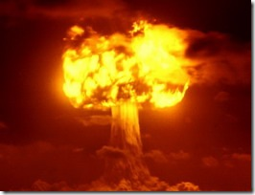
3. CIA Gives the Soviets Gas (1982)
Disaster: Control software went haywire and produced intense pressure in the Trans-Siberian gas pipeline, resulting in the largest man-made non-nuclear explosion in Earth’s history.
Cost: Millions of dollars, significant damage to Soviet economy
Cause: CIA operatives allegedly planted a bug in a Canadian computer system purchased by the Soviets to control their gas pipelines. The purchase was part of a strategic Soviet plan to steal or secretly obtain sensitive U.S. technology. When the CIA discovered the purchase, they sabotaged the software so that it would pass Soviet inspection but fail in operation.

Slide 12

4. World War III… Almost (1983)
Disaster: The Soviet early warning system falsely indicated the United States had launched five ballistic missiles. Fortunately the Soviet duty officer had a “funny feeling in my gut” and reasoned if the U.S. was really attacking they would launch more than five missiles, so he reported the apparent attack as a false alarm.
Cost: Nearly all of humanity
Cause: A bug in the Soviet software failed to filter out false missile detections caused by sunlight reflecting off cloud-tops.

Slide 13
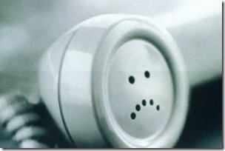
5. AT&T Lines Go Dead (1990)
Disaster: A single switch at one of AT&T’s 114 switching centers suffered a minor mechanical problem and shut down the center. When the center came back up, it sent a message to other switching centers, which in turn caused them to shut down and brought down the entire AT&T network for 9 hours.
Cost: 75 million phone calls missed, 200 thousand airline reservations lost.
Cause: A single line of buggy code in a complex software upgrade implemented to speed up calling caused a ripple effect that shut down the network.
Dr. Seemab Latif

Slide 14
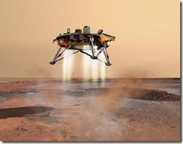
6. Mars Climate Crasher (1998)
Disaster: After a 286-day journey from Earth, the Mars Climate Orbiter fired its engines to push into orbit around Mars. The engines fired, but the spacecraft fell too far into the planet’s atmosphere, likely causing it to crash on Mars.
Cost: $125 million
Cause: The software that controlled the Orbiter thrusters used imperial units (pounds of force), rather than metric units (Newtons) as specified by NASA.

Slide 15
What is Software Quality?
In the context of software engineering, software quality measures:
how well software is designed (quality of design), and
how well the software conforms to that design (quality of conformance)
The totality of functionality and features of a software product that bear on its ability to satisfy stated or implied needs. [After ISO 9126]

Slide 16
Introduction
Software Testing,
Software Quality Assurance,
Software Quality Control
&
Software Quality Engineering

Slide 17
What is QE, QA, QC and Testing
Quality Engineering (QE), Quality Assurance (QA), Quality Control (QC), and Testing are related, but they are different concepts. All these four are useful to manage risks of developing and managing software.
Quality Engineering: A set of operational, managerial, and engineering activities that a company uses to ensure that the quality characteristics of a product are at the nominal or required levels.
Quality Assurance: A set of activities designed to ensure that the development and/or maintenance process is adequate to ensure a system will meet its objectives.
Quality Control: A set of activities designed to evaluate a developed work product.
Testing: The process of executing a system with the intent of finding defects.

Slide 18
Scope and Content Hierarchy
Software Quality Engineering
Software Quality Assurance
Software Quality Control
Software Testing
Software Testing, Software Quality Assurance (SQA) , Software Quality Control (SQC) & Software Quality Engineering (SQE)

Slide 19
Difference Between QA, QC and Testing
QA is process oriented
QC and Testing are product oriented.
Quality Assurance makes sure you are doing the right things, the right way.
Quality Control makes sure the results of what you've done are what you expected.

Slide 20
What is Testing?
Risk management
Confidence management
Part (but not all) of quality assurance
The tests are not the goal
Why we need Testing?
Avoid disasters
Avoid legal nightmares
Increase productivity
Testing brings confidence
Confidence reduces worry
Worry decreases productivity
Good testing should be an integral part of good programming.

Slide 21
Role of Testing
Static Analysis
Verification
Dynamic Analysis
Validation

Slide 22
Role of Testing
Testing plays an important role in achieving and assessing the quality of a software product. On the one hand, we improve the quality of the products as we repeat a test–find defects–fix cycle during development.
Friedman and Voas have concisely described, software testing is a verification process for software quality assessment and improvement.
The activities for software quality assessment can be divided into two broad categories, namely, static analysis and dynamic analysis.

Slide 23
Static Analysis
As the term “static” suggests, it is based on the examination of a number of documents, namely requirements documents, software models, design documents, and source code.
Traditional static analysis includes code review, inspection, walk-through, algorithm analysis, and proof of correctness.
It does not involve actual execution of the code under development. Instead, it examines code and reasons over all possible behaviours that might arise during run time. Compiler optimisations are standard static analysis.

Slide 24
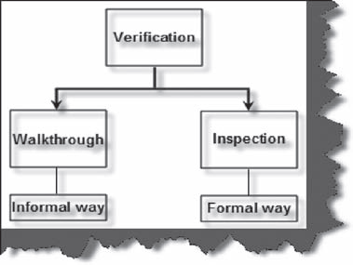
Verification
Verification is a static analysis in which the system is reviewed without actually running the application.
Two types of verification methods:
Walk through: is an informal form of verification. For instance, you can call your colleague and do an informal walkthrough to just check if the coding and documentation is correct.
Inspection: is a formal procedure and official. For instance, in your organization you can have an official body which approves design documents for any project.

Slide 25
Dynamic Analysis
Dynamic analysis of a software system involves actual program execution in order to expose possible program failures. The behavioural and performance properties of the program are also observed.
Programs are executed with both typical and carefully chosen input values. Therefore, in testing, we observe some representative program behaviours and reach a conclusion about the quality of the system.

Slide 26
Validation
Validation is a dynamic analysis which tests the system by actually executing the code.

Slide 27
Defect, Fault, Error and Failure
Behavior Chain:
Defect
Fault
Error
Failure

Slide 28
Failure
Failure: is said to occur whenever the external behavior of the system does not conform to that prescribed in the system specifications.
According to Ram Chillarege, Software Failure means:
“the customer’s expectations has not been met and/or the customer is unable to do useful work with the product”

Slide 29
Error
Error: is a state of a system.
In the absence of any corrective action by the system, an error state could lead to a failure which would not be attributed to any event subsequent to the error.
Dr. Seemab Latif

Slide 30
Fault
Fault: is an adjudged cause of an error.
Fault remain undetected for a long time, until some event activates it.
When an event activates a fault, it first brings the program in an intermediate error state.
If computation is allowed to proceed from an error state without any corrective action, the program eventually causes a failure.
In fault tolerant computing, corrective actions can be taken to take a program out of an error state into a desirable state such that subsequent computation does not lead to a failure.

Slide 31
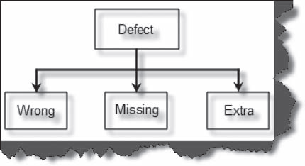
Defect
Defect: is a variance from the user requirements.
Categories of Defects:
Wrong: The requirements have been implemented incorrectly.
Missing: There was a requirement given by the customer and it was not done.
Extra: A requirement incorporated into the product that was not given by the end customer.

Slide 32
Types of Defects
Two types:
Latent Defect
Masked Defect
A latent defect is an existing defect that has not yet caused a failure because the exact set of conditions were never met.
A masked defect is an existing defect that hasn’t yet caused a failure just because another defect has prevented that part of the code from being executed.
Dr. Seemab Latif

Slide 33
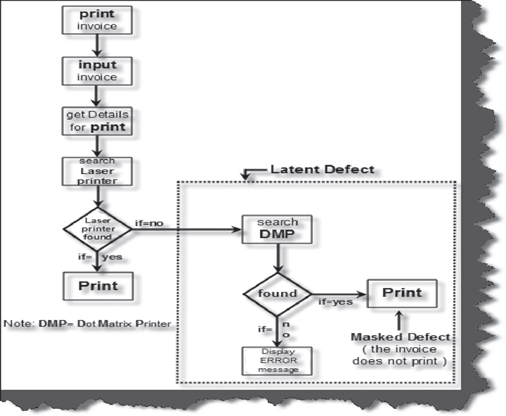
Example of Latent and Masked Defect
Dr. Seemab Latif

Slide 34
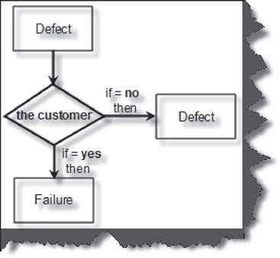
Difference between Defect and Failure
Defect may lead to system failure.
When a defect reaches the end user it is called as failure and if it is detected internally and resolved, it is called a defect.

Slide 35
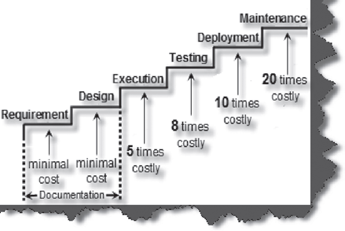
Cost of defects
The cost of defects increases exponentially. A defect caught in requirement and design phase costs less to fix than an error caught in the software maintenance cycle.
Cost of defect increases with each phase

Slide 36
Software Reliability
No matter how many times the test-find fault-fix cycle run on the software, some faults are likely to escape.
A quantitative measure is required, that is useful in assessing the quality of a software---reliability.
Software reliability is the probability of failure-free operations of a software for a specified time in a specified environment.
Level of reliability depends on the inputs that cause failure to be observe by the end user.
Since the notion of reliability is specific to a “specified environment,” test data must be drawn from the input distribution to closely resemble the future usage of the system.

Slide 37
Objectives of Testing
Four objectives of Testing:
It does work
It does not work
Reduce the risk of failure
Reduce the cost of testing

Slide 38
1. It does work
While implementing a program unit, the programmer may want to test whether or not the unit works in normal circumstances. The programmer gets much confidence if the unit works to his or her satisfaction. Same idea applies to the entire system.
Objective of testing is to show that the system works, rather than it does not work.

Slide 39
2. It does not work
Once the programmer or the development team is satisfied that a unit or the system works to a certain degree, more tests are conducted with the objective of finding faults in the unit or the system.
Here, the idea is to try to make the unit or the system fail.
Dr. Seemab Latif

Slide 40
3. Reduce the Risk of Failure
Most of the complex software systems contain faults, which cause the system to fail from time to time. This concept of “failing from time to time” gives rise to the notion of failure rate.
As faults are discovered and fixed while performing more and more tests, the failure rate of a system generally decreases.
Thus, a higher level objective of performing tests is to bring down the risk of failing to an acceptable level.

Slide 41
4. Reduce the cost of Testing
The different kinds of costs associated with a test process include:
the cost of designing, maintaining, and executing test cases,
the cost of analysing the result of executing each test case,
the cost of documenting the test cases, and
the cost of actually executing the system and documenting it.

Slide 42
Reduce the cost of Testing
Therefore, the less the number of test cases designed, the less will be the associated cost of testing. However, producing a small number of arbitrary test cases is not a good way of saving cost.
The highest level of objective of performing tests is to produce low-risk software with fewer number of test cases. This idea leads us to the concept of effectiveness of test cases. Test engineers must therefore judiciously select fewer, effective test cases.

Slide 43
What is a Test Case?
a test case is a simple pair of <input, expected outcome>.
If a program under test is expected to compute the square root of nonnegative numbers, then four examples of test cases are
TB1: <0, 0>,
TB2: <25, 5>,
TB3: <40, 6.3245553>,
TB4: <100.5, 10.024968>

Slide 44
Test Cases for Stateless System
In stateless systems, where the outcome depends solely on the current input, test cases are very simple in structure.
A program to compute the square root of nonnegative numbers is an example of a stateless system.
A compiler for the C programming language is another example of a stateless system. A compiler is a stateless system because to compile a program it does not need to know about the programs it compiled previously.

Slide 45
Test Cases for State-Oriented System
In state-oriented systems, where the program outcome depends both on the current state of the system and the current input, a test case may consist of a sequence of <input, expected outcome> pairs.
A telephone switching system and an automated teller machine (ATM) are examples of state-oriented systems.
For an ATM machine, a test case for testing the withdraw function is:
Here, we assume that the user has already entered validated inputs, such as the cash card and the personal identification number (PIN).
TS1: <check balance, $500.00>, <withdraw, ‘‘amount?’’>,
<$200.00, ‘‘$200.00’’>, <check balance, $300.00>.

Slide 46
Concept of Complete Testing
“I have exhaustively tested the program.”
Complete, or exhaustive, testing means there are no undiscovered faults at the end of the test phase.
For most of the systems, complete testing is near impossible because of the following reasons:

Slide 47
Reason 1
The domain of possible inputs of a program is too large to be completely used in testing a system. There are both valid inputs and invalid inputs.
The program may have a large number of states. There may be timing constraints on the inputs, that is, an input may be valid at a certain time and invalid at other times. An input value which is valid but is not properly timed is called an inopportune input.
The input domain of a system can be very large to be completely used in testing a program.

Slide 48
Reason 2
The design issues may be too complex to completely test.
The design may have included implicit design decisions and assumptions.
For example, a programmer may use a global variable or a static variable to control program execution.

Slide 49
Reason 3
It may not be possible to create all possible execution environments of the system.
This becomes more significant when the behaviour of the software system depends on the real, outside world, such as weather, temperature, altitude, pressure, and so on.

Slide 50
Summary
Why Software Quality Assurance is important?
Discuss some of the famous software disasters.
What is Software Testing, Quality Assurance and Software Quality Control.
Scope and Content Hierarchy.
Difference between software Testing, Quality Assurance and Software Quality Control.
What is software testing, its role and objectives and software reliability.
Defined and explained defect, fault, error and failure.
Described test cases.
Concept of complete testing and what are the reasons that limit complete testing.

Slide 51
References
Software Quality Engineering: Testing, Quality Assurance, and Quantifiable Improvement: JEFF TIAN, 2005.
http://www.devtopics.com/20-famous-software-disasters/
http://www.mosaicinc.com/mosaicinc/rmThisMonth.asp
Software Testing, Interview Questions: S. KOIRALA and S. SHEIKH, 2008

